Slide 1
KSHEERA
By-
BHUVAN PRATAP AGARWAL - 19311A05B0
VINEETH YELAGANDULA - 19311A0588
M. SRINATH - 19311A0594

Slide 2
KSHEERA AUV
01
ABSTRACT
04
REQUIREMENTS
02
INTRODUCTION
UML
05
03
Existing SYSTEMS
06
CONCLUSION

Slide 3
ABSTRACT
The Problem:
The problem statement we have selected is that people who are in the fishing industry or who go fishing find it difficult in knowing the exact location or approximate site of the best fishing(high quantity and quality fish(swordfish, tuna fish, etc.))
We need to use an Remotely Operated Vehicle to survey the area of the ocean.
So that the time of being at the fishing location could be used more effectively and productively.
The team’s approach to solving the problem:
Our idea is to build a network of robots that moves inside the sea or ocean wherever the fishing is done in a specified area with the basic knowledge and get the data(microplastic concentration, ph, temperature, dissolved oxygen, etc.) of conditions of the ocean or sea, analyze the data and compares with the data which favors the fish and suggests the best area of fishing.

Slide 4
INTRODUCTION
Marine technology has been developing from the ages for deep-water explorations and other forms of analysis of large water bodies. Aquatic conditions have never been easy for inquiry tasks, and a lot of research has been put in recent years, to explore the oceans and seas in harsh climatic conditions. ROUVs and UUVs have substantial applications in surveillance, ocean exploration, pollution monitoring, sea patrolling etc. The deep-water quest is one of the essential applications for which the research has picked up the pace in recent years.
Underwater Terrain is very hard to reach and very expensive to do research and
organize search operations.
Many avenues of underwater marine life and oceanographic developments are not
observed as widely as they are supposed to be. AUVs are used to detect life and do
search operations very quickly and efficiently which would save a lot of lives and
time. The problem statement we have selected is that people who are in the fishing
industry or who go fishing find it difficult in knowing the exact location or
approximate site of the best fishing (high quantity and quality fish(swordfish,
tuna fish, etc.)) so that the time of being at the fishing location could be used
more effectively and productively.

Slide 5
Existing System
Requires planning to cover the water network. Ganga water cleaning is a task initiated by the govt. of
India is one such work. Several zones are distributed all over the country. Concerned authorities move
people for sample collection and brought them back to the laboratory for testing. But the timeline may
not need sample validity duration. This is also true for the sea and ocean. Fisherman goes around the
sea to locate the right type of fish and sometimes comes back with an empty hand. There are some
boats with instrumentation that patrols the specific area and collects the sample. Samples are further
tested at a laboratory. There are boat-based systems reported from china, japan, etc. These systems are
instrumented with GPS, communication system and sample collection system, and measurement
system. They do the measurement at the surface level. But, the majority of parameters are required to
monitor at 3 to 6 feet depth.

Slide 6
SOFTWARE REQUIREMENT
MATLAB
04
JUPYTER NOTEBOOK
03
ARDUINO IDE
02
RASPBIAN OS
01

Slide 7
HARDWARE REQUIREMENTS
01
RASPBERRY PI
MOTORS
02
03
SENSORS
COMMUNICATION MODULE
04
05
HOUSING
WIRES, BATTERY, CONNECTORS
06
07
LAPTOP / PC

Slide 8
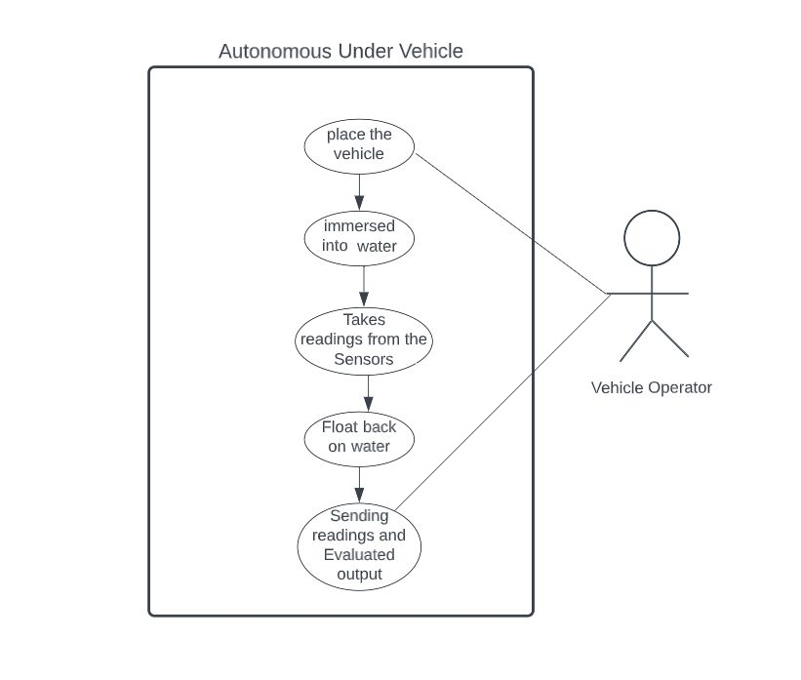
UML DIAGRAMS

Slide 9
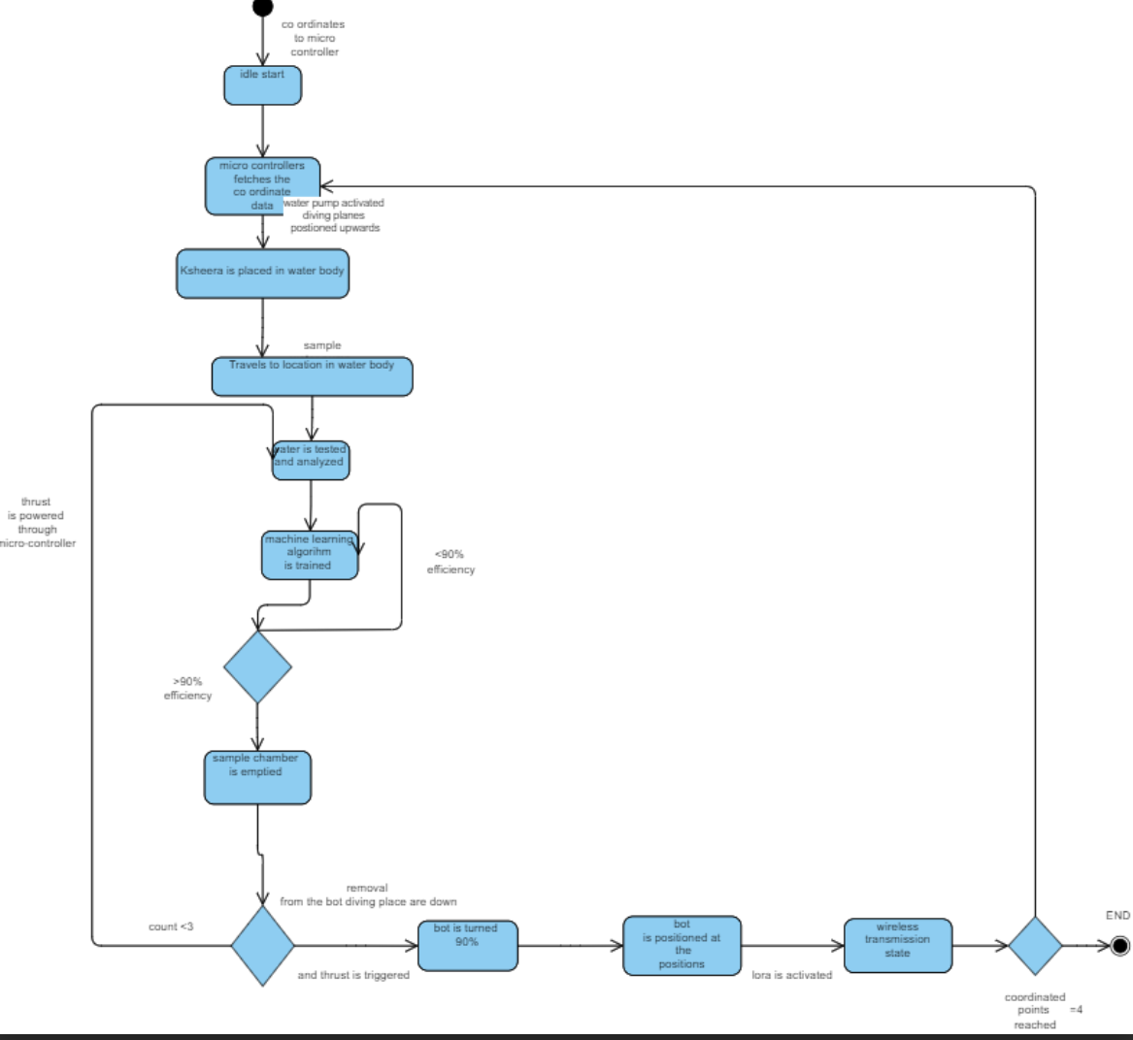
UML DIAGRAMS

Slide 10
CODE SNIPPETS
const int dirPin = 10;
const int stepPin = 11; const int stepsPerRevolution = 4096;
void setup()
{
// Declare pins as Outputs
pinMode(stepPin, OUTPUT);
pinMode(dirPin, OUTPUT);
} void loop()
{
// Set motor direction clockwise
digitalWrite(dirPin, HIGH);
// Spin motor slowly
for(int x = 0; x < stepsPerRevolution; x++)
{
digitalWrite(stepPin, HIGH);
delayMicroseconds(1000);
digitalWrite(stepPin, LOW);
delayMicroseconds(1000);
}
delay(1000);
// Wait a second
// Set motor direction counterclockwise
digitalWrite(dirPin, LOW);
// Spin motor quickly
for(int x = 0; x < stepsPerRevolution; x++)
{
digitalWrite(stepPin, HIGH);
delayMicroseconds(1000); digitalWrite(stepPin, LOW);
delayMicroseconds(1000);
}
delay(1000); // Wait a second
}

Slide 11
CONCLUSION
Autonomous underwater vehicle development is a critical field of study for scientific research in numerous industrial applications such as defense, ocean future uses and development, a summary of the main navigation, mapping, sampling technologies, and their applications. This paper also considers the structural representation of the vehicle as the shape largely determines the movement, stability, fluid resistance, etc. The control system This paper also gives a comprehensive analysis between various UUVs and ROUVs.

Slide 12
FUTURE SCOPE

Slide 13
REFERENCES

Slide 14
Machine Learning Infographics
01
Active learning
Maturation
02
Mercury is the closest planet to the Sun
Jupiter is a gas giant and the biggest planet
03
Motor synergies
Imitation
04
The Earth is the planet where we live
Despite being red, Mars is a cold place

Slide 15
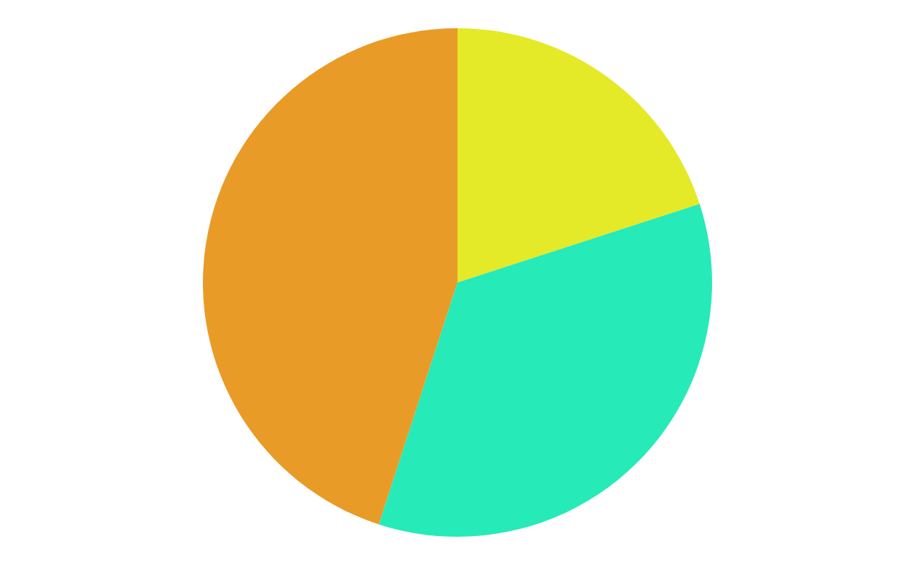
Machine Learning Infographics
45%
20%
Data mining
Intrusion detection
The Earth is the third planet from the Sun
Mercury is the closest planet to the Sun
35%
Continuous production
Despite being red, Mars is a very cold place
Follow the link in the graph to modify its data and then paste the new one here. For more info, click here

